Slide 2
6/15
Must stop

Slide 3
8/15
Mustn't stop or park

Slide 4
UNIT 6
SURVIVAL
LESSON 5: LANGUAGE FOCUS
must and should

Slide 5
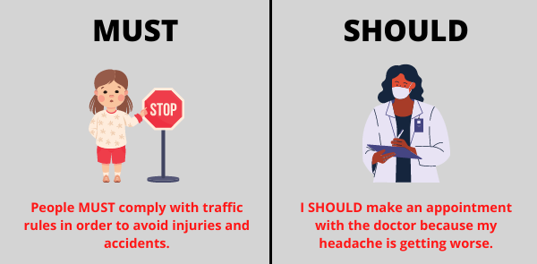

Slide 6
✔ Activity 1: Look at these sentences about Kay Freeman’s Desert Challenge. Write true or false.
1 You must be fit to go on the Desert Challenge.
2 You mustn’t leave the group.
3 You should take a map.
4 You shouldn’t wear shorts and a T-shirt.
true
true
false
true

Slide 7
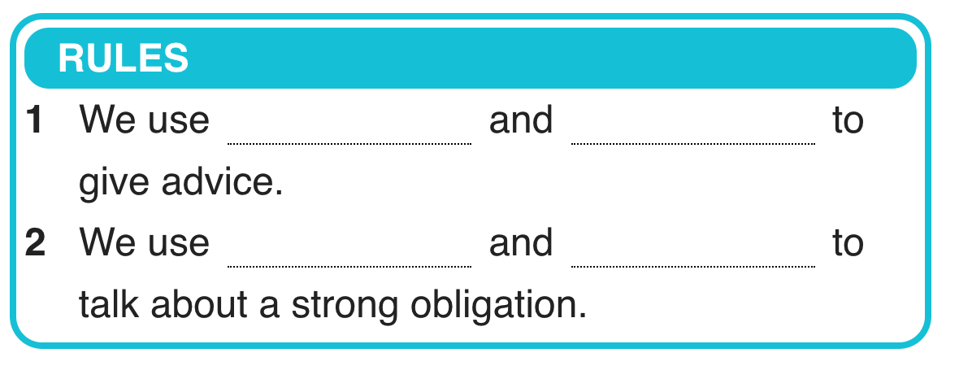
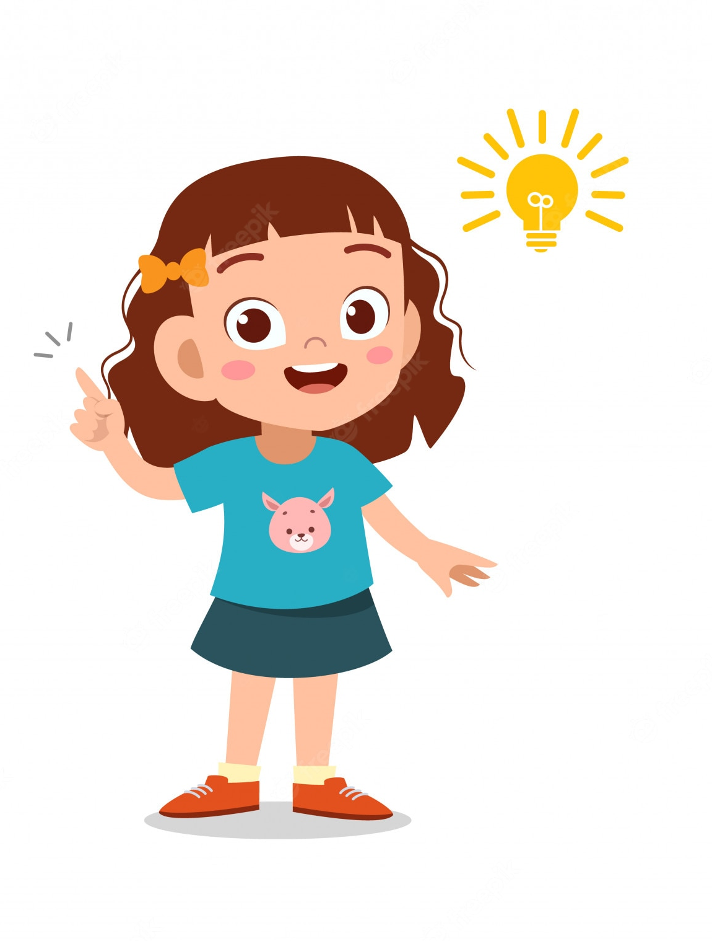
✔ Activity 2: Study the sentences in exercise 1 and complete the Rules with must, mustn’t, should and shouldn’t.
should
shouldn't
must
mustn't

Slide 8
✔ Activity 3: Correct the mistakes in the sentences.
1 You must to have a medical certificate. ✗
…………………………………………………………………………………
2 He should works harder. ✗
…………………………………………………………………………………
3 We should not to camp near a river. ✗
…………………………………………………………………………………
4 They don’t must take their dog. ✗
…………………………………………………………………………………
You must have a medical certificate.
He should work harder.
We should not camp near a river.
They mustn't take their dog.

Slide 9
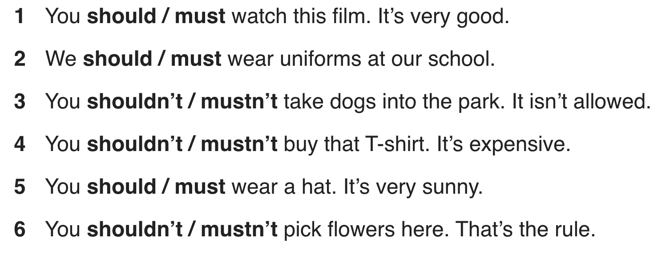
✔ Activity 4: Choose the correct words.

Slide 10
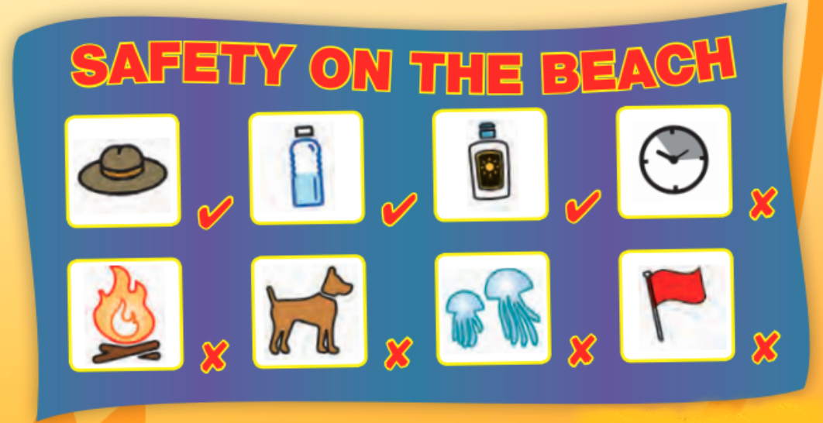
✔ Activity 5: Look at the signs. Write sentences with should, shouldn't, must or mustn't. and the prompts.
wear / hat
You should wear a hat.
1 bring / water
………………………………………………………..
2 make / fire
………………………………………………………
3 use / sunscreen
………………………………………………………
4 come / between 11 a.m. and 3 p.m.
………………………………………………………
5 swim / red flag
………………………………………………………
6 touch / jellyfish
………………………………………………………
7 bring / your dog
………………………………………………………
You should bring water.
You mustn’t make a fire.
You should use sunscreen.
You shouldn't come between 11 a.m. and 3 p.m.
You mustn’t swim when there's a red flag.
You shouldn't touch jellyfish.
You mustn’t bring a dog.

Slide 11
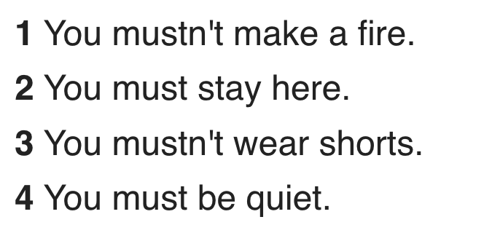
✔ Activity 6: PRONUNCIATION /ʌ/ in must, and silent t in mustn't Listen to the sentences. Then listen again and repeat.

Slide 13
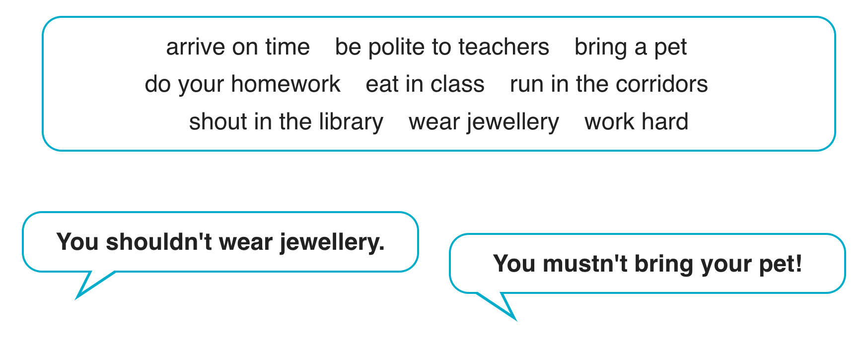
✔ Activity 7: USE IT! Work in pairs. Give advice and make rules for your school. Use the ideas in the box and your own ideas. Then compare your ideas with another pair's.

Slide 14
- Learn by heart all the new words. - Workbook: Exercises p.41 - Prepare Lesson 6 – Speaking

